Slide 1
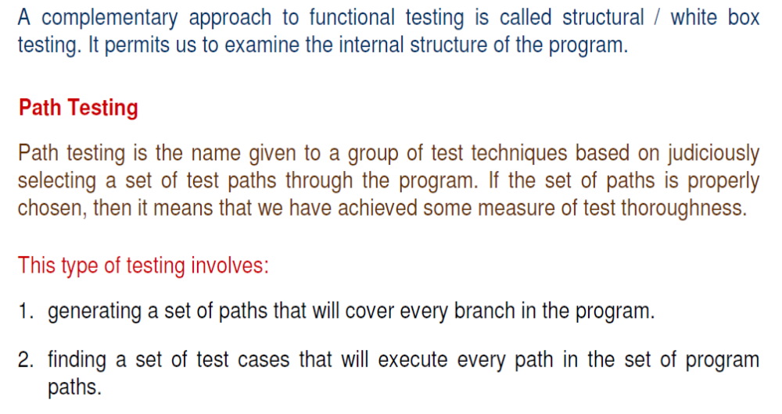
Software Testing
Structural testing

Slide 2
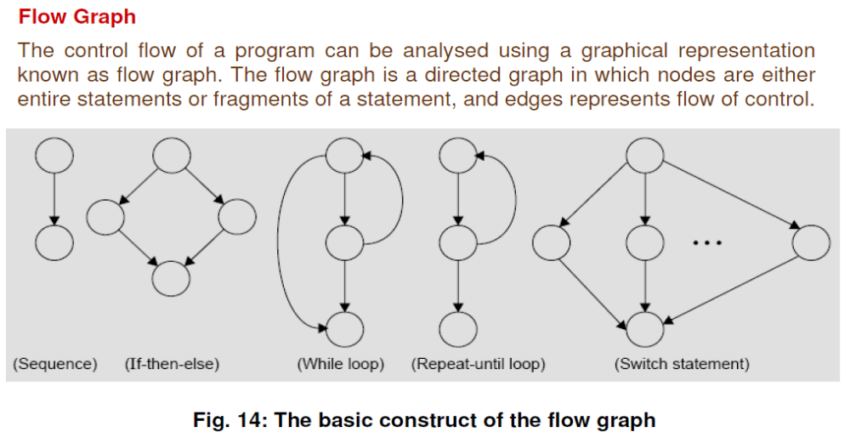
Software Testing
Structural testing

Slide 3
1. #include <stdio.h>
2. int main()
3. {
4. int num1, num2;
5. printf("Enter two integers :");
6. scanf("%d%d", &num1, &num2);
7. if (num1 > num2)
8. {
9. printf("Largest number is %d.", num1);
10. }
11.else
12. {
13. printf("Largest number is %d.", num2);
14. }
15. }

Slide 4
Flow Graph
DD Path Graph
Independent Paths :

Slide 5
1. #include<stdio.h>
2. #include<conio.h>
3. void main()
4. { int a, b, big;
5. printf("Enter any two number: ");
6. scanf("%d%d", &a, &b);
7. if(a>b)
8. big=a;
9. else
10. big=b;
11. printf("\nBiggest of the two number is: %d", big);
12. getch();
13. }

Slide 7
1. #include <stdio.h>
2. Int main()
3. {
4. int A, B, C;
5. printf("Enter three numbers: ");
6. scanf("%d %d %d", &A, &B, &C);
7. if (A >= B) {
8. if (A >= C)
9. printf("%d is the largest number.", A);
10. else
11. printf("%d is the largest number.", C);
12. }
13. else {
14. if (B >= C)
15. printf("%d is the largest number.", B);
16. else
17. printf("%d is the largest number.", C);
18 . }
19. }

Slide 8
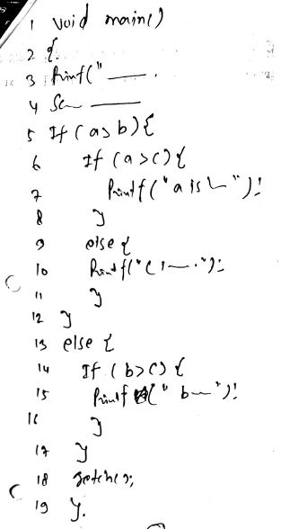
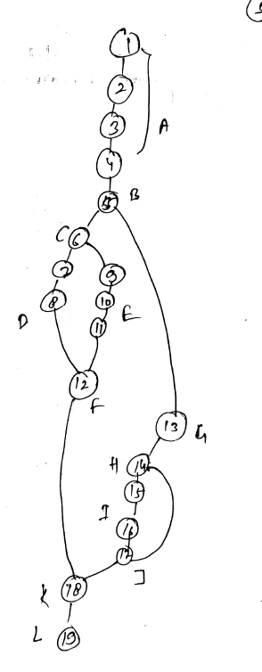

Slide 9
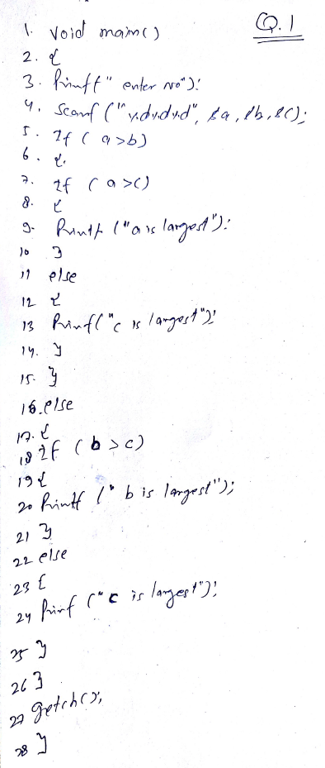
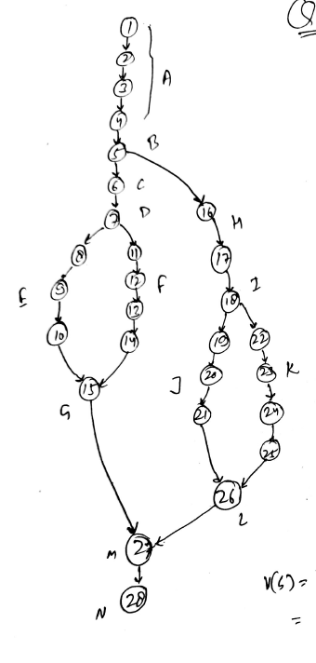

Slide 10
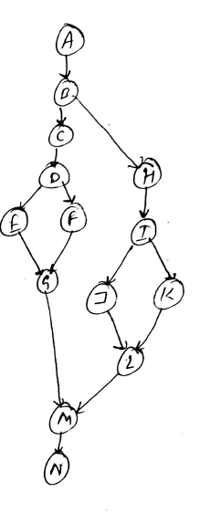
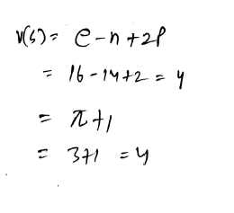

Slide 11
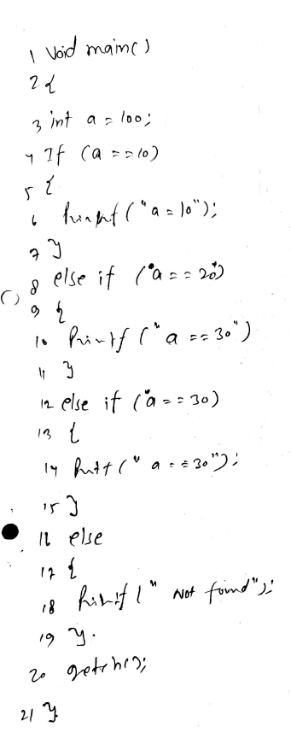
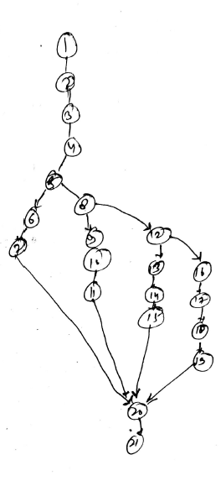

Slide 12
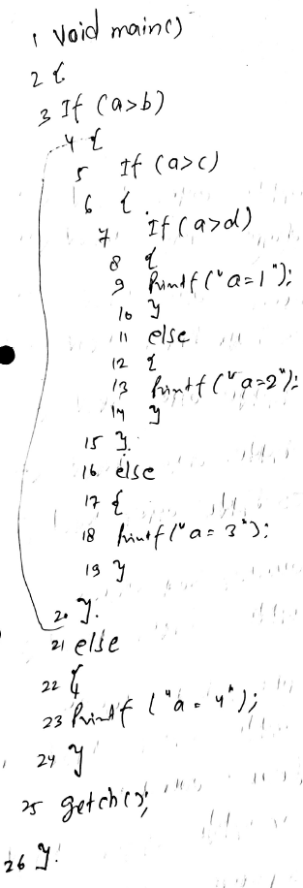
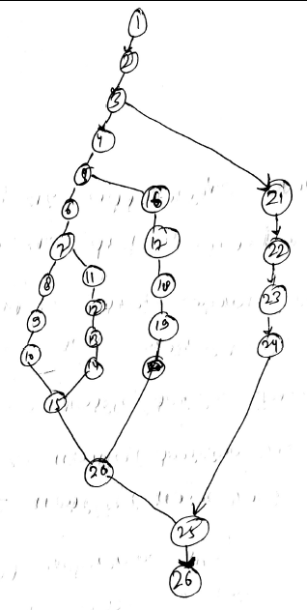

Slide 13
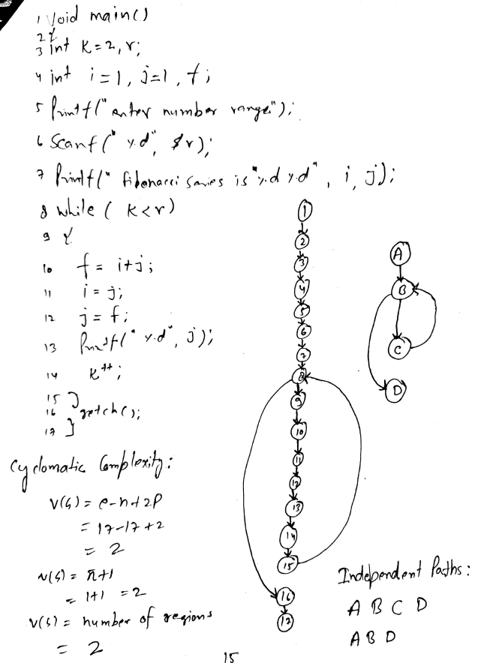

Slide 14
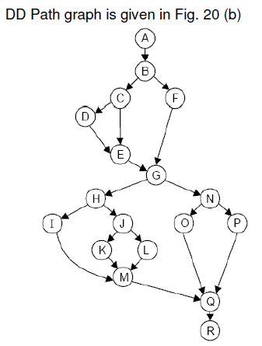
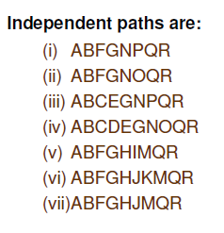

Slide 15
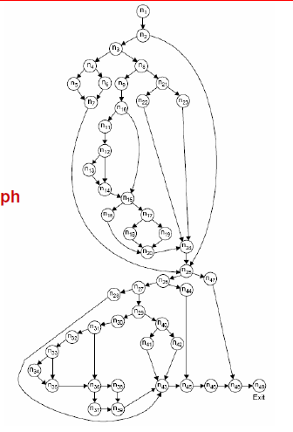

Slide 16
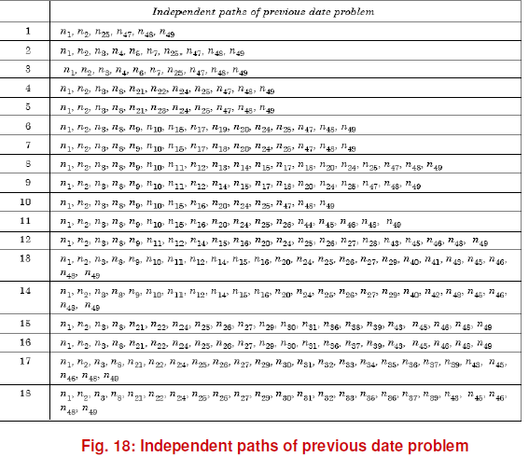

Slide 17
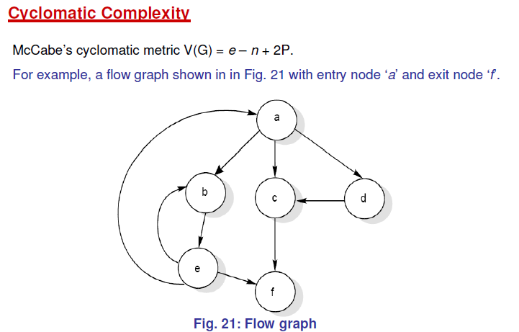

Slide 18
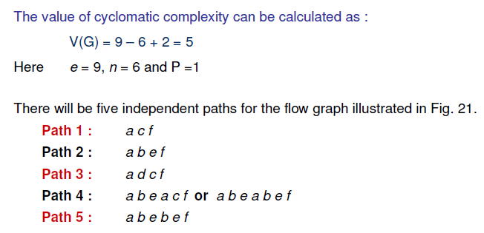

Slide 19
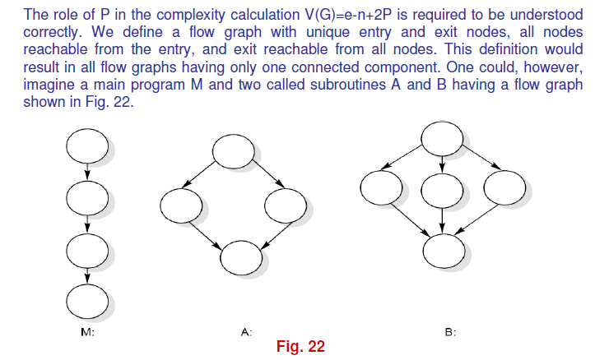

Slide 20
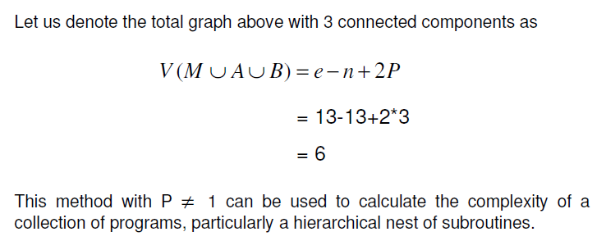

Slide 21
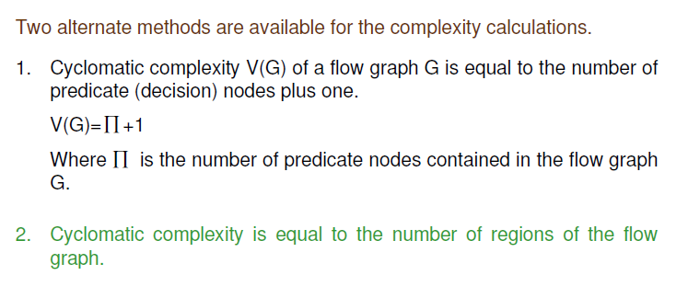

Slide 22
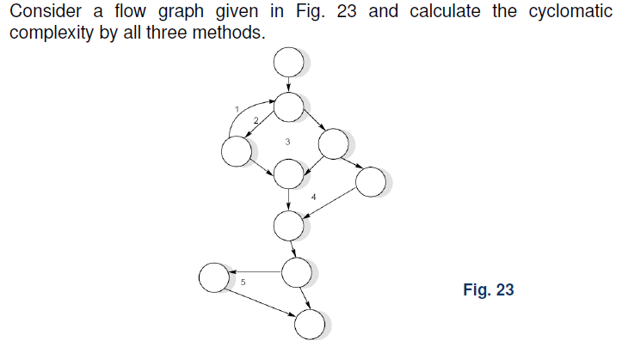

Slide 23
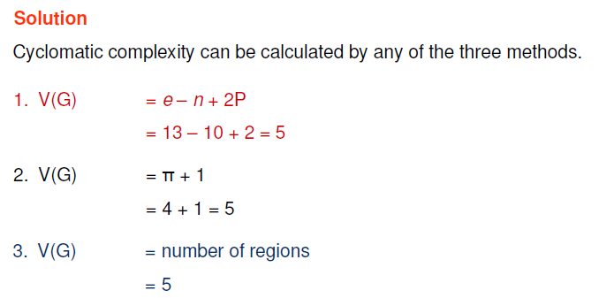

Slide 24
References
K.K. Aggarwal and Yogesh Singh, “Software Engineering”, Third Ed., New Age International (P) Limited Publishers. (2009).
Roger S. Pressman, “Software Engineering: A Practitioner’s Approach”, Fifth Ed., McGraw–Hill Higher Education, (2001).
Rajib Mall, “Fundamentals of Software Engineering”,Fourth Ed., PHI Learning Private Limited, (2016).
Pankaj Jalote, “An Integrated Approach to Software Engineering”, Third Ed., Narose Publishing House, (2008).

Slide 25
Thanks…

